Slide 1
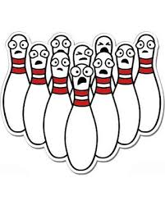
Kingpin Bowling Tracker
By: Darius Grasseschi, Evan Hassan, Jonathan Lacoursiere, Ariana Lee, Maria Medina, and Cody Trombley

Slide 2
Project Vision
Our vision is to develop the “Kingpin Bowling Tracker” application to enable present bowling leagues to create and manage leagues, and to provide individual bowlers detailed history and statistics for analyzing their game over the course of their league seasons.

Slide 3
Features
Project will consist of two components - A web app and a mobile app
Web App
Allow Bowling Center managers to create and manage Leagues
Allow League Officers to create leagues with their own unique rulesets
Manage weekly league duties
Determine lane pairings
Import scores
Track team points
Provide detailed league statistics

Slide 4
Features - cont
Mobile App
Allow authenticated league bowlers to view their game histories and stats

Slide 5
Project Stakeholders
Bowling Centers
League Governing Bodies
Individual League Members
The United States Bowling Congress

Slide 6
Project Plan
Discuss the project’s general idea and come up with specifications
Divide tasks among team members
Set up GitHub and Django project
Detailed project planning
Create database and user login
Simultaneously work on web app and mobile app
Work on individual features
Final testing

Slide 7
Tools and Technologies
Communication: GroupMe, Slack, & Discord
Web Framework: Django
Tools required:
Command line interface (CLI)
Any web browser
Programming languages: Python, Javascript, & SQL
Markup: HTML
Styling: Bootstrap 4 CSS
Backend Database: MySQL
Version control: GitHub

Slide 8
Development Environment
Web App
Brackets
Mobile App
Android Device Studio

Slide 9
Risks
Poor time management among members of the group
Learning curve of working with new platforms that some of us aren’t very experienced in.
Plans to mitigate these risks include:
Regular team meetings and project status updates
Division of labor between all members of the group based on our particular skills
Use of a project management tool, such as Microsoft Project or Project Libre, to keep track of time

Slide 10
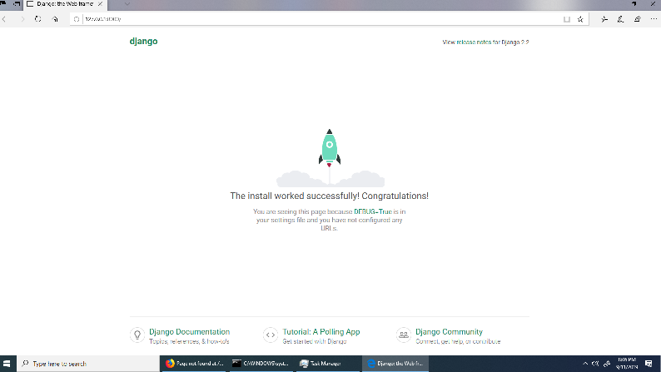
Server Setup
Django’s built-in web server

Slide 11
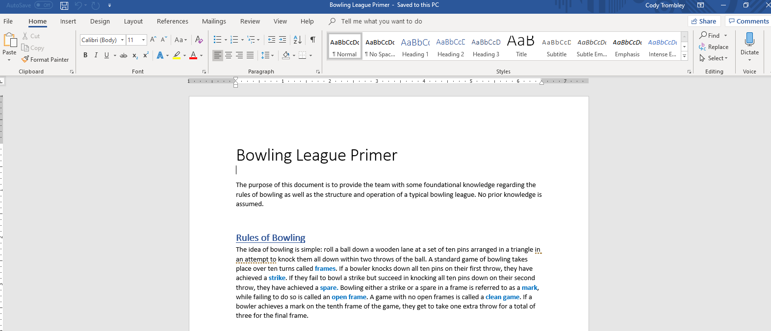
Bowling League Information

Slide 12
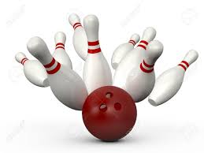

THANK YOU
Any Questions?

